Slide 1
CS 310 Operating Systems Lecture 1: Operating System Introduction Role of OS as an Illusionist, a Referee and a glue
Ravi Mittal
IIT Goa

Slide 2
Acknowledgements !
Contents of this class presentation have been taken from various sources. Thanks are due to the original content creators:
Class presentation: University of California, Berkeley: David Culler, Anthony D. Joseph, John Kubiatowicz, AJ Shankar, George Necula, Alex Aiken, Eric Brewer, Ras Bodik, Ion Stoica, Doug Tygar, and David Wagner
Book: Operating Systems: Principles and Practice (2nd Edition) Anderson and Dahlin, Volume 1

Slide 3
Read the following:
Operating Systems: Principles and Practice (2nd Edition) Anderson and Dahlin
Volume 1, Kernel and Processes
Section: 1.1, 1.2, and 1.3

Slide 4



We will study..
What is an Operating System?
OS Role: An Illusionist
OS Role: A Referee
OS Role: A Glue

Slide 5
What is an Operating System?

Slide 6
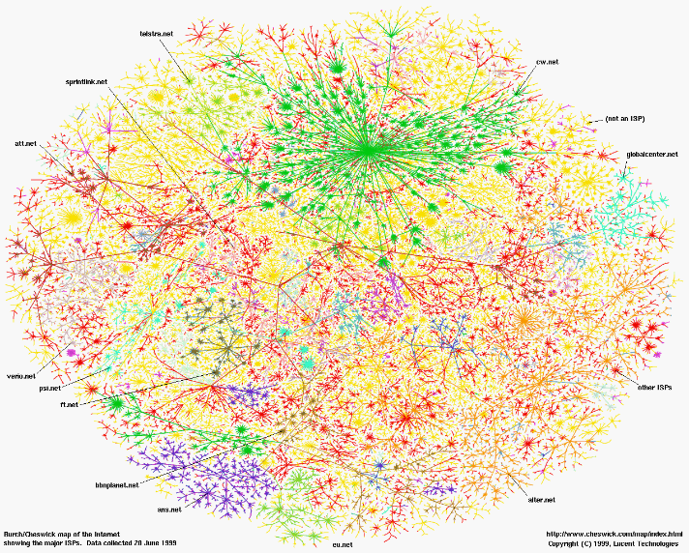
Greatest Artifact of Human Civilization…
Kubiatowicz CS162 © UCB Spring 2021

Slide 7
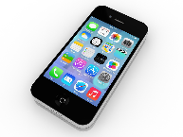
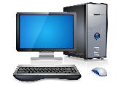

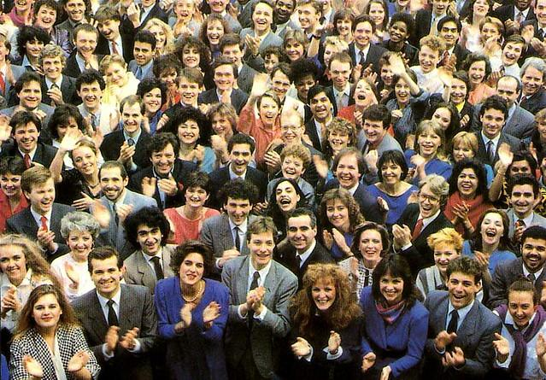

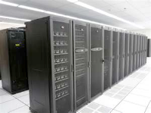
Greatest Artifact of Human Civilization…
The Internet!
Kubiatowicz CS162 © UCB Spring 2021

Slide 8
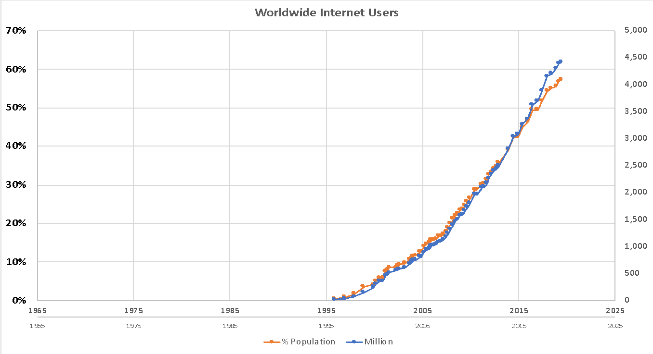
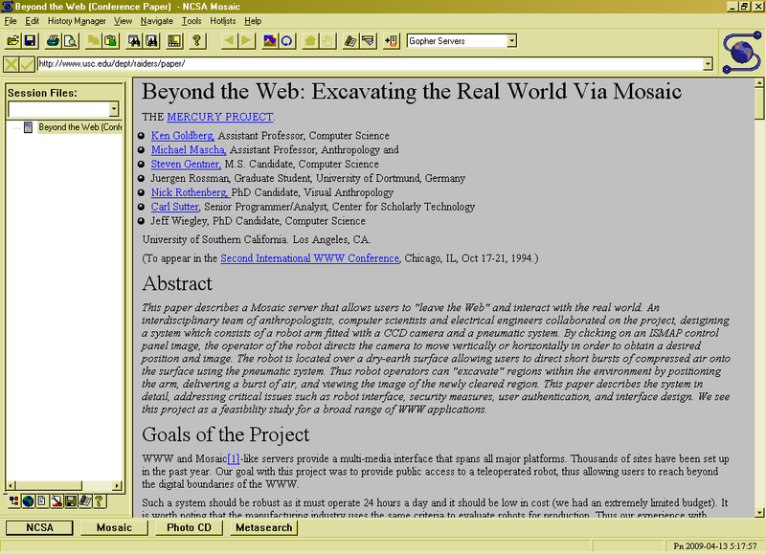
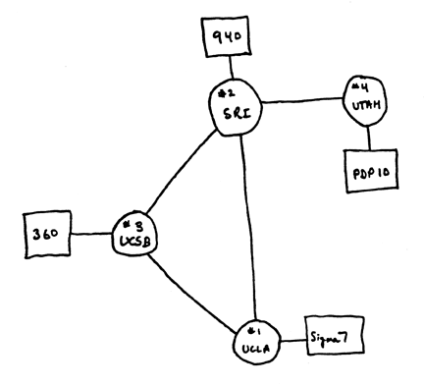
Running Systems at Internet Scale
Internet
WWW
RFC 675 TCP/IP
ARPANet
HTTP 0.9
1969
1974
1990
Kubiatowicz CS162 © UCB Spring 2021

Slide 9
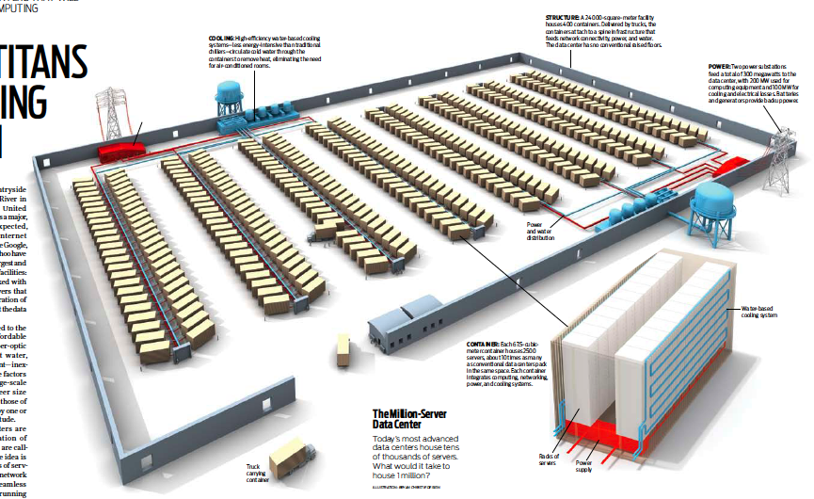
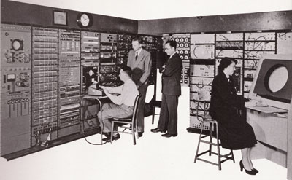
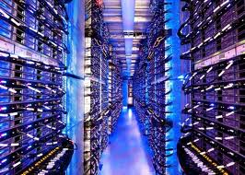
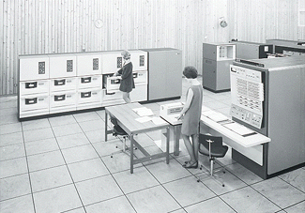
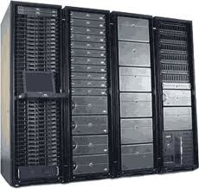
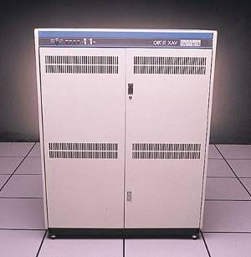
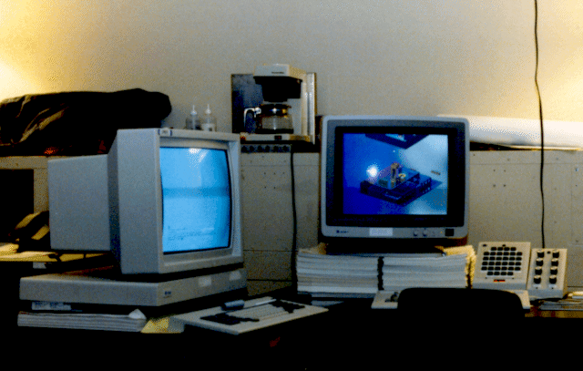
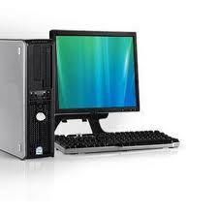
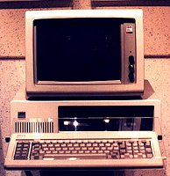
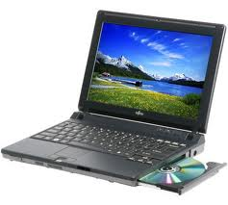
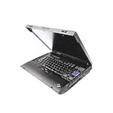
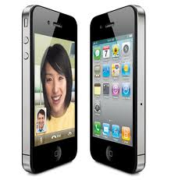

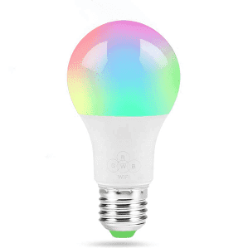

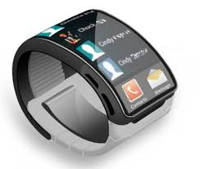
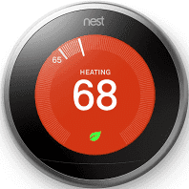
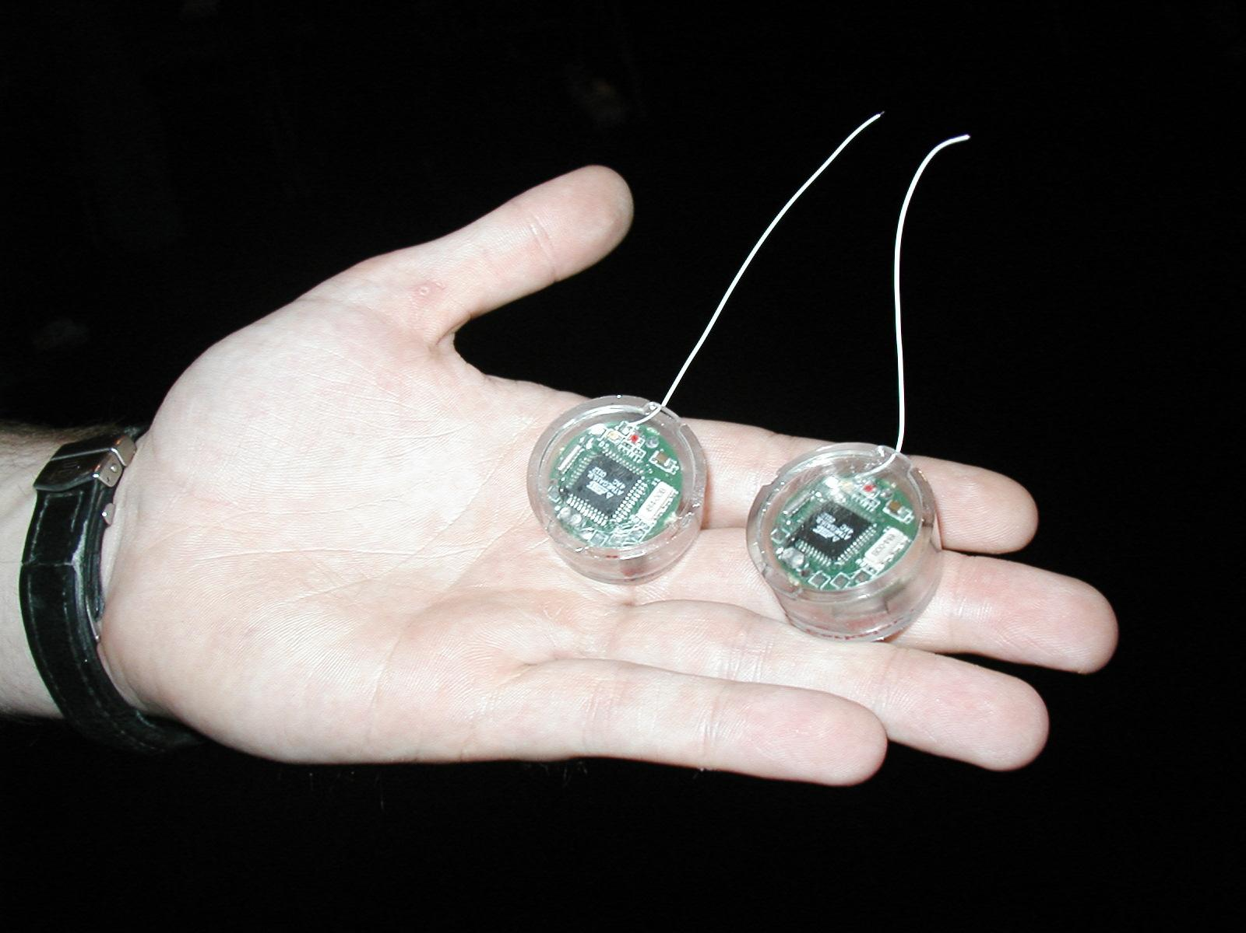
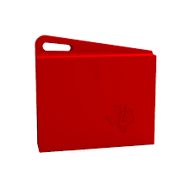
Across Incredible Diversity
Computers
Per Person
Number crunching, Data Storage, Massive Inet Services,
ML, …
1:10⁶
Mainframe
Bell’s Law: New computer class every 10 years
Mini
1:10³
Workstation
Productivity,
Interactive
PC
1:1
Laptop
PDA
Cell
Streaming from/to the physical world
10³:1
years
Mote!
The Internet of Things!
Kubiatowicz CS162 © UCB Spring 2021

Slide 10
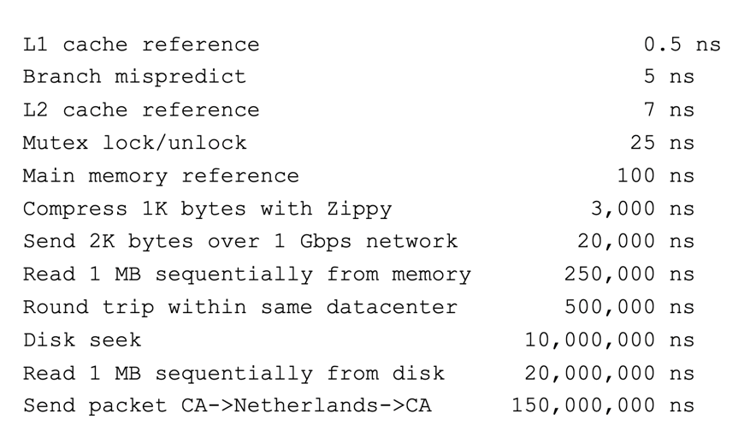
And Range of Timescales
“Numbers that Everyone Should Know”
One source of complexity in Computers: Dealing with components that are widely diverse in functionality and timing
Kubiatowicz CS162 © UCB Spring 2021

Slide 11
Operating Systems are at the Heart of it All!
Make the incredible advance in the underlying technology available to a rapidly evolving body of applications
Provide consistent abstractions to applications, even on different hardware
Manage sharing of resources among multiple applications
The key building blocks:
Processes
Threads, Concurrency, Scheduling, Coordination
Address Spaces
Protection, Isolation, Sharing, Security
Communication, Protocols
Persistent storage, transactions, consistency, resilience
Interfaces to all devices
Kubiatowicz CS162 © UCB Spring 2021

Slide 12
But: What is an operating system?

Slide 13
What is an operating system?
Special layer of software that provides application software access to hardware resources
Convenient abstraction of complex hardware devices
Protected access to shared resources
Security and authentication
Communication amongst logical entities
appl n
appln
appln
OS
Hardware
Kubiatowicz CS162 © UCB

Slide 14
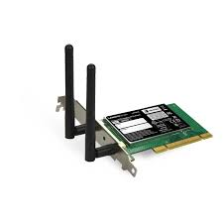
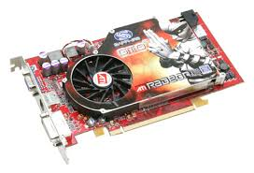
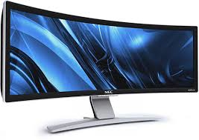

Hardware/Software Interface
Running Program
Software
What you learned in CS 211 – Computer Architecture
Instruction Set Architecture (ISA)
Hardware
Memory
Page Table
& TLB
Processor
Cache
OS Memory
Networks
The OS abstracts these hardware details from the application
Ctrlr
Storage
Inputs
Displays
Kubiatowicz CS162 © UCB Spring 2021

Slide 15
What does an Operating System do?
We know:
Memory Management
I/O Management
CPU Scheduling
Communication support?
Multitasking/multiprogramming
What about?
File System?
Multimedia Support?
User Interface?
Kubiatowicz CS162 © UCB Spring 2021

Slide 16
Definition of an Operating System
No universally accepted definition
“Everything a vendor ships when you order an operating system” is good approximation
But varies wildly
The one program running at all times on the computer is the kernel
Everything else is either a system program (ships with the operating system) or an application program
Kubiatowicz CS162 © UCB Spring 2021

Slide 17
What is an Operating System? Role 1: Illusionist
It must provide illusion of
clean, easy-to-use abstractions of physical resources
Infinite memory, dedicated machine
Higher level objects: files, users, messages
Masking limitations, virtualization
Illusionist

Slide 18
What is an Operating System? An Illusionist !

Slide 19
OS Basics: Virtualizing the Machine
Compiled
Program
System Libs
Process: Execution environment with restricted rights provided by OS
Threads
Address Spaces
Files
Sockets
Operating System
ISA
Processor
PgTbl
& TLB
Memory
Storage
Networks
Hardware
OS Mem
I/O Ctrlr
Kubiatowicz CS162 © UCB Spring 2021

Slide 20
Compiled Program’s View of the World
Compiled
Program
System Libs
Process: Execution environment with restricted rights provided by OS
Threads
Address Spaces
Files
Sockets
Operating System
Application’s “machine” is the process abstraction provided by the OS
Each running program runs in its own process
Processes provide nicer interfaces than raw hardware
Processor
PgTbl
& TLB
Memory
Storage
Networks
Hardware
OS Mem
I/O Ctrlr
Kubiatowicz CS162 © UCB Spring 2021

Slide 21

System Programmer’s View of the World
Program
System Libs
Linker
Compiler
Process: Execution environment with restricted rights provided by OS
Threads
Address Spaces
Files
Sockets
Operating System
ISA
Application’s “machine” is the process abstraction provided by the OS
Each running program runs in its own process
Processes provide nicer interfaces than raw hardware
Processor
PgTbl
& TLB
Memory
Storage
Networks
Hardware
OS Mem
I/O Ctrlr
Kubiatowicz CS162 © UCB Spring 2021

Slide 22
What’s in a Process?
A process consists of:
Address Space
One or more threads of control executing in that address space
Additional system state associated with it
Open files
Open sockets (network connections)
…
OS creates and runs process
Kubiatowicz CS162 © UCB Spring 2021

Slide 23
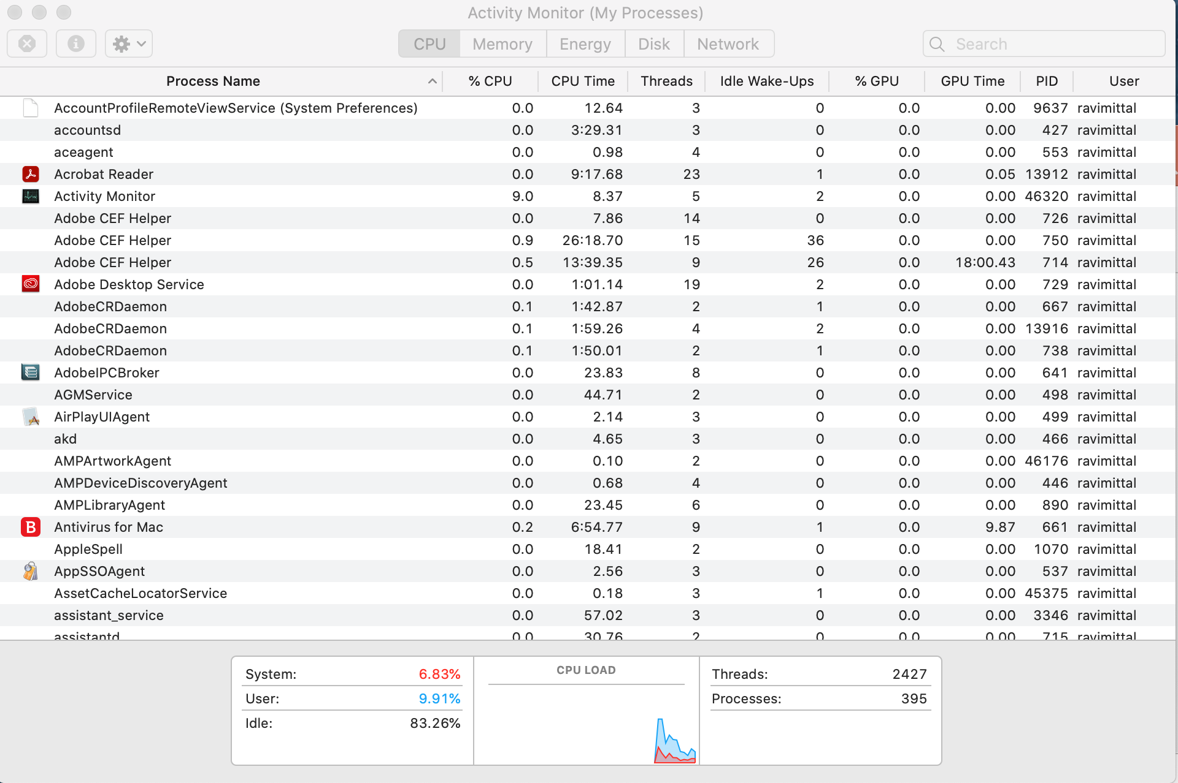
For Example…Processes running on my laptop

Slide 24
Operating System’s View of the World
Compiled
Program 1
Compiled
Program 2
System Libs
System Libs
Compiler
Process 1
Process 2
Threads
Address Spaces
Files
Sockets
Threads
Address Spaces
Files
Sockets
Operating System
ISA
Processor
PgTbl
& TLB
Memory
Storage
Networks
Hardware
OS Mem
I/O Ctrlr
Kubiatowicz CS162 © UCB Spring 2021

Slide 25
Operating System’s View of the World
Running
Program 1
Running
Program 2
OS translates from hardware interface to application interface
OS provides each running program with its own process
System Libs
System Libs
Compiler
Process 1
Process 2
Threads
Address Spaces
Files
Sockets
Threads
Address Spaces
Files
Sockets
Operating System
ISA
Processor
PgTbl
& TLB
Memory
Storage
Networks
Hardware
OS Mem
I/O Ctrlr
Kubiatowicz CS162 © UCB Spring 2021

Slide 26
What is an Operating System? A Referee!

Slide 27
What is an Operating System? Role 2: Referee
It must
Manage protection, isolation, and sharing of resources
Resource allocation and communication
It creates and runs processes
Referee
Kubiatowicz CS162 © UCB Spring 2021

Slide 28
OS Basics: Running a Process
Compiled
Program 1
Compiled
Program 2
System Libs
System Libs
Compiler
Process 1
Process 2
Threads
Address Spaces
Files
Sockets
Threads
Address Spaces
Files
Sockets
Operating System
ISA
Processor
PgTbl
& TLB
Memory
Storage
Networks
Hardware
I/O Ctrlr
Kubiatowicz CS162 © UCB Spring 2021

Slide 29
OS Basics: Switching Processes
Compiled
Program 1
Compiled
Program 2
System Libs
System Libs
Compiler
Process 1
Process 2
Threads
Address Spaces
Files
Sockets
Threads
Address Spaces
Files
Sockets
Operating System
ISA
Processor
PgTbl
& TLB
Memory
Storage
Networks
Hardware
OS
Mem
I/O Ctrlr
Kubiatowicz CS162 © UCB Spring 2021

Slide 30
OS Basics: Switching Processes
Compiled
Program 1
Compiled
Program 2
System Libs
System Libs
Compiler
Process 1
Process 2
Threads
Address Spaces
Files
Sockets
Threads
Address Spaces
Files
Sockets
Operating System
ISA
Processor
PgTbl
& TLB
Memory
Storage
Networks
Hardware
OS
Mem
I/O Ctrlr
Kubiatowicz CS162 © UCB Spring 2021

Slide 31
OS Basics: Switching Processes
Compiled
Program 1
Compiled
Program 2
System Libs
System Libs
Compiler
Process 1
Process 2
Threads
Address Spaces
Files
Sockets
Threads
Address Spaces
Files
Sockets
Operating System
ISA
Processor
PgTbl
& TLB
Memory
Storage
Networks
Hardware
OS
Mem
I/O Ctrlr
Kubiatowicz CS162 © UCB Spring 2021

Slide 32
OS Basics: Switching Processes
Compiled
Program 1
Compiled
Program 2
System Libs
System Libs
Compiler
Process 1
Process 2
Threads
Address Spaces
Files
Sockets
Threads
Address Spaces
Files
Sockets
Operating System
ISA
Processor
PgTbl
& TLB
Memory
Storage
Networks
Hardware
OS
Mem
I/O Ctrlr
Kubiatowicz CS162 © UCB Spring 2021

Slide 33
OS Basics: Protection
Compiled
Program 1
Compiled
Program 2
System Libs
System Libs
Compiler
Process 1
Process 2
Threads
Address Spaces
Files
Sockets
Threads
Address Spaces
Files
Sockets
Operating System
ISA
Processor
PgTbl
& TLB
Memory
Storage
Networks
Hardware
OS
Mem
I/O Ctrlr
Kubiatowicz CS162 © UCB Spring 2021

Slide 34
OS Basics: Protection
Compiled
Program 1
Segmentation fault (core dumped)
Compiled
Program 2
System Libs
System Libs
Compiler
Process 1
Process 2
Threads
Address Spaces
Files
Sockets
Threads
Address Spaces
Files
Sockets
Operating System
ISA
Processor
PgTbl
& TLB
Memory
Storage
Networks
Hardware
OS
Mem
I/O Ctrlr
Kubiatowicz CS162 © UCB Spring 2021

Slide 35
OS Basics: Protection
Process 1
Process 2
Process 3
OS isolates processes from each other
OS isolates itself from other processes
… even though they are actually running on the same hardware!
Software
OS Hardware Virtualization
Hardware
ISA
Memory
Processor
OS Memory
Ctrlr
Displays
Storage
Networks
Inputs
Kubiatowicz CS162 © UCB Spring 2021

Slide 36
What is an Operating System? A Glue !

Slide 37
What is an Operating System? Role 3: Glue
OS plays a key role in providing a set of common and standard services to applications
It provides
The same look Look and feel
Common features like CTRL-C, CTRL-V
Example: A webserver must be able to read file that a text editor wrote
Standard file format
Standard file and directory system
Standard way of applications to pass messages and share memories
Kubiatowicz CS162 © UCB Spring 2021

Slide 38
Example: File system in an OS
Referee
Prevents others from accessing the file system without permission
Reuse storage space after files are deleted
Illusionist
File grows and shrinks without user knowing about it
File can exist on RAID or multiple storage devices
Invisible to user
Files persist even during certain hardware faults
Glue
Directories
Standard APIs for file I/O

Slide 39
OS Basics: I/O
Process 1
Process 2
Process 3
Software
OS Hardware Virtualization
Hardware
ISA
Memory
OS provides common services in the form of I/O
Processor
Protection
OS Memory
Ctrlr
Displays
Storage
Networks
Inputs
Kubiatowicz CS162 © UCB Spring 2021

Slide 40
OS Basics: Look and Feel
Compiled
Program
System Libs
Compiler
Process: Execution environment with restricted rights provided by OS
Threads
Address Spaces
Files
Sockets
Windows
Operating System
ISA
Processor
PgTbl
& TLB
Memory
Storage
Networks
Displays
Hardware
OS Mem
I/O Ctrlr
Kubiatowicz CS162 © UCB Spring 2021

Slide 41

OS Basics: Background Management
Compiled
Program
System Libs
Compiler
Process: Execution environment with restricted rights provided by OS
Threads
Address Spaces
Files
Sockets
Windows
Operating System
Network Manager
Power Manager
ISA
Processor
PgTbl
& TLB
Memory
Storage
Networks
Displays
Battery
Hardware
OS Mem
I/O Ctrlr
Kubiatowicz CS162 © UCB Spring 2021

Slide 42
Structure of General Purpose OS
Book: OS Principles and Practices: Anderson and Dahlin

Slide 43
Summary: What is an Operating System?
Referee
Manage protection, isolation, and sharing of resources
Resource allocation and communication
Illusionist
Provide clean, easy-to-use abstractions of physical resources
Infinite memory, dedicated machine
Higher level objects: files, users, messages
Masking limitations, virtualization
Glue
Common services
Storage, Window system, Networking
Sharing, Authorization
Look and feel

